Slide 1
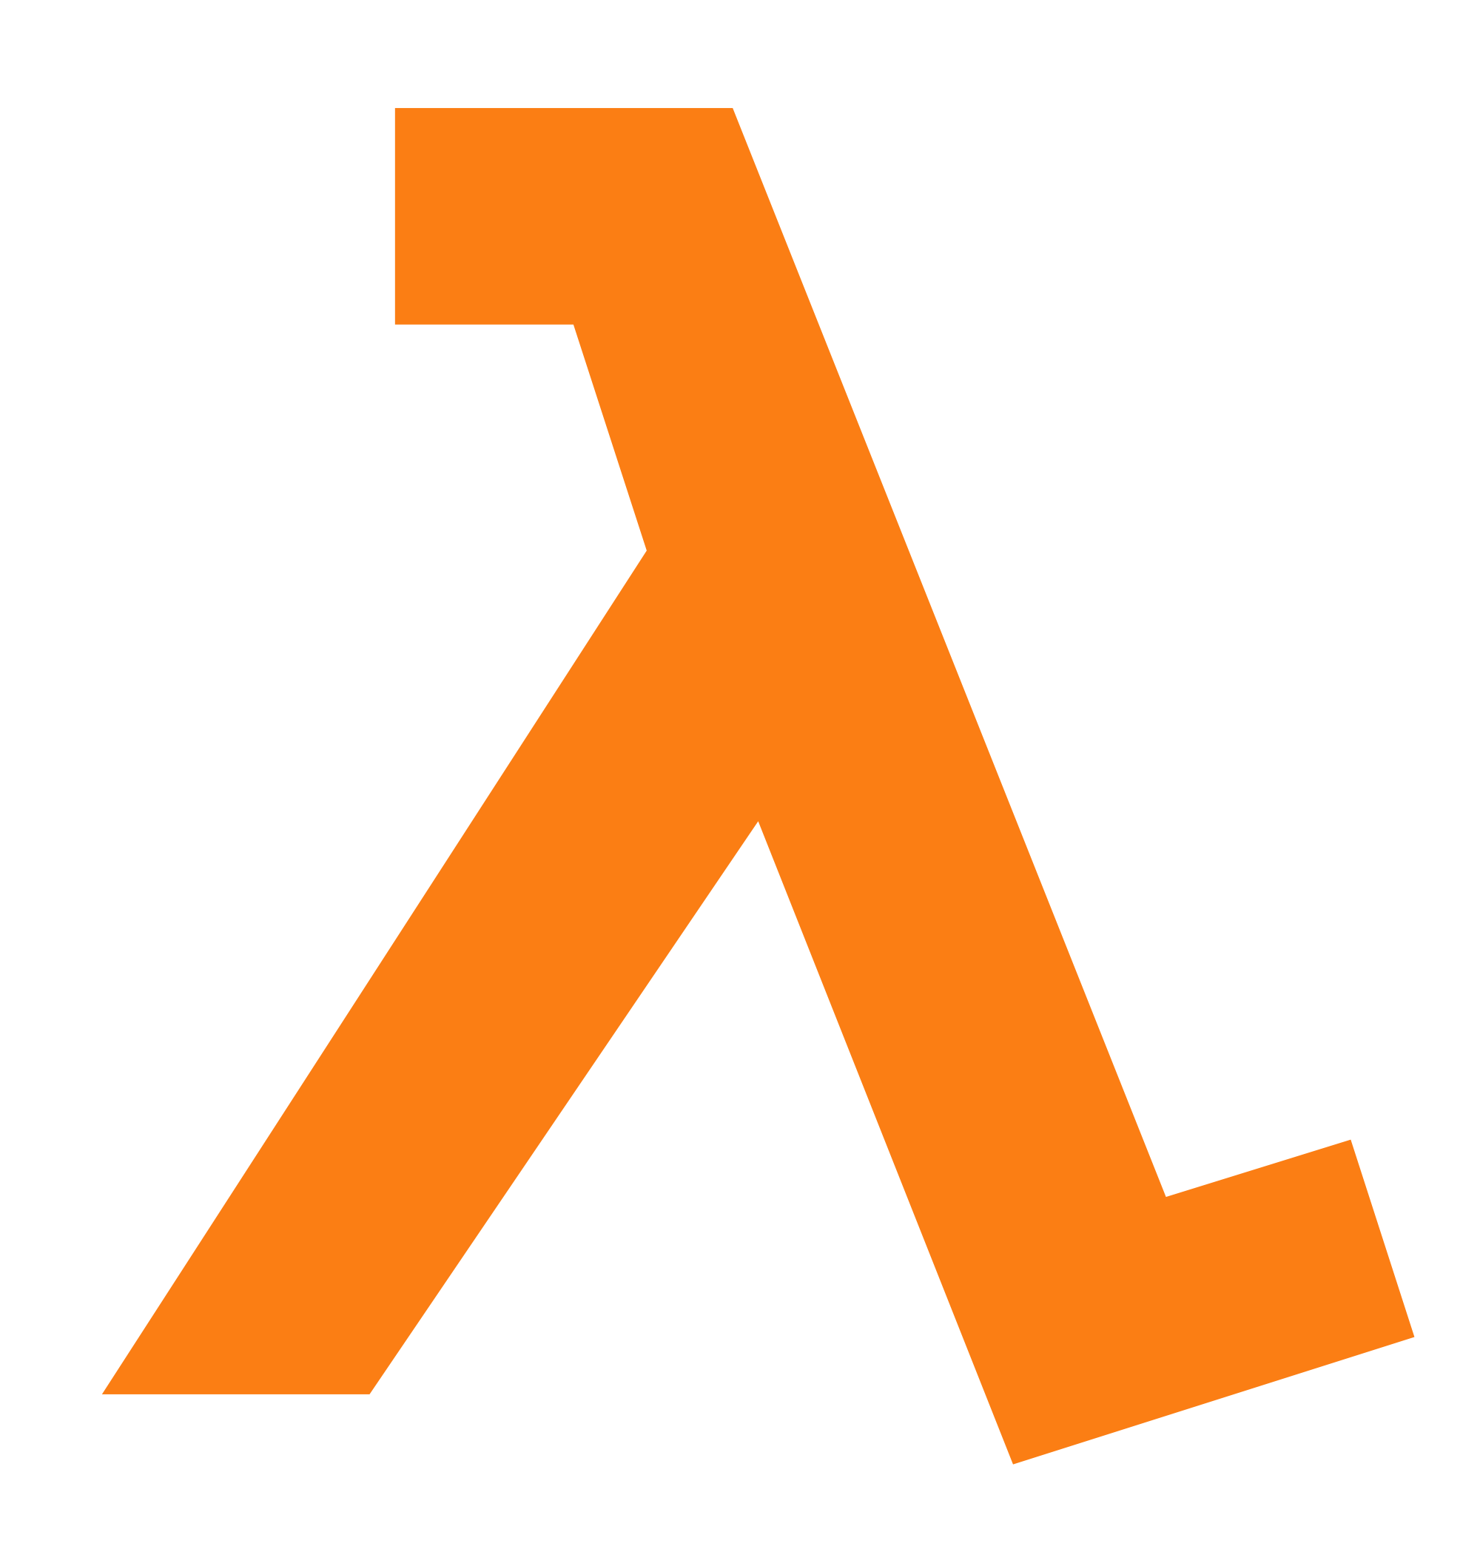
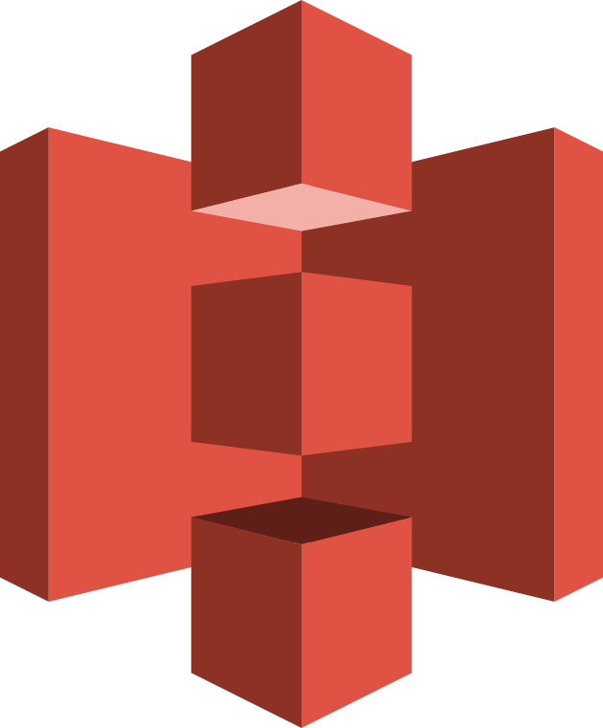
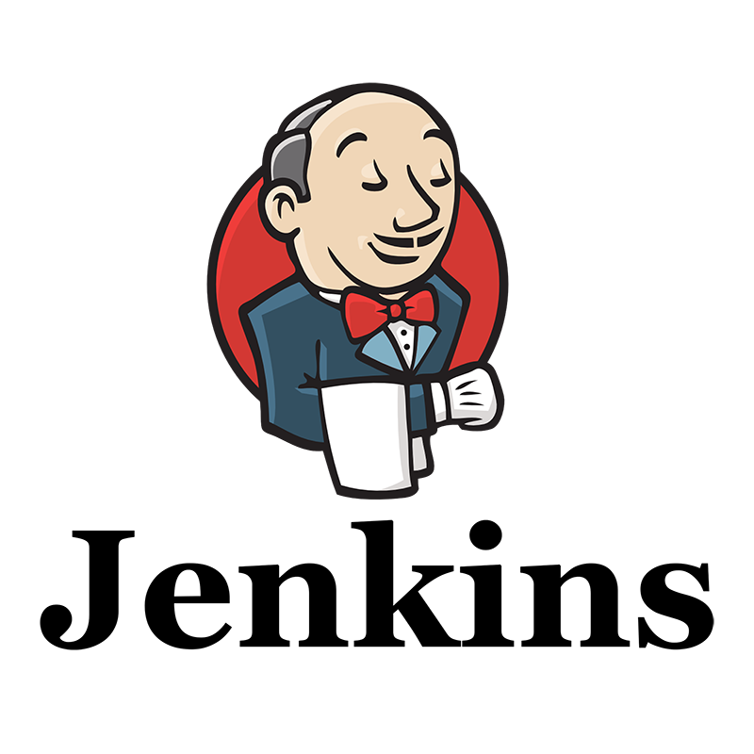

serverless Application deployment
Presented by Anurag

Slide 2

Serverless?
Serverless computing allows you to focus on writing code without managing servers. AWS Lambda, a serverless computing service, is typically used for this purpose.

Slide 3
Project Overview
Objective: Automating the deployment of a serverless application using Jenkins and Docker, hosted on AWS EC2.
Key Goals:
Streamline CI/CD pipeline for deployment.
Use Jenkins for automation, Docker for containerization, and AWS EC2 for cloud deployment.

Slide 4
Diagram
Explanation:
GitHub Repo: Holds the project code.
Jenkins: Automates the build, test, and deployment process.
Lambda: Holds the backend code of your Application
S3: Holds the frontend code

Slide 5
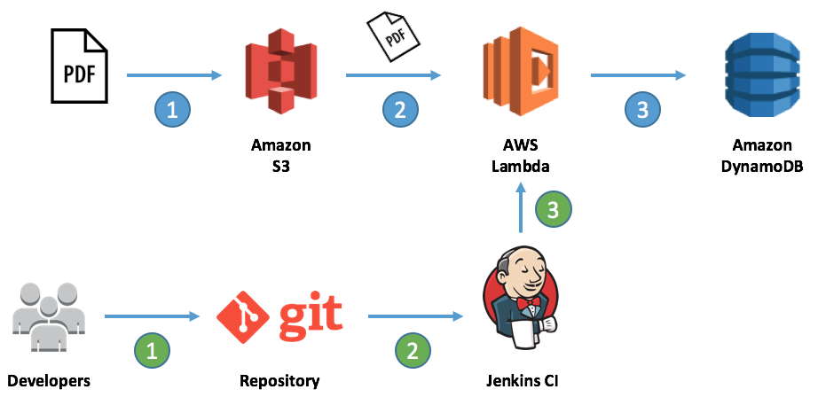
Flow Diagram

Slide 6
Deployment Pipeline Overview
Code Checkout: Pull the latest code from GitHub.
Backend Setup: Install dependencies and configure Serverless Framework.
Frontend Build: Compile the frontend application.
Upload to S3: Sync the built frontend to AWS S3.
Deploy Backend: Use the Serverless Framework to deploy the backend to AWS Lambda.

Slide 7
Quote
Technologies Used

Slide 8

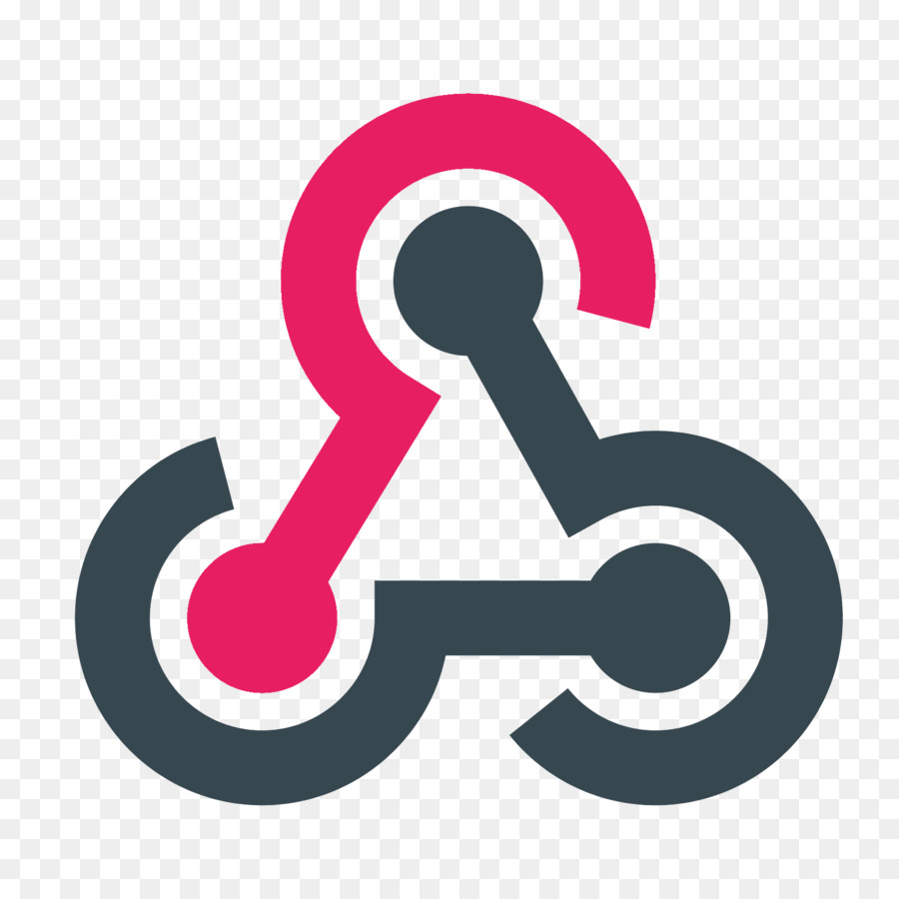
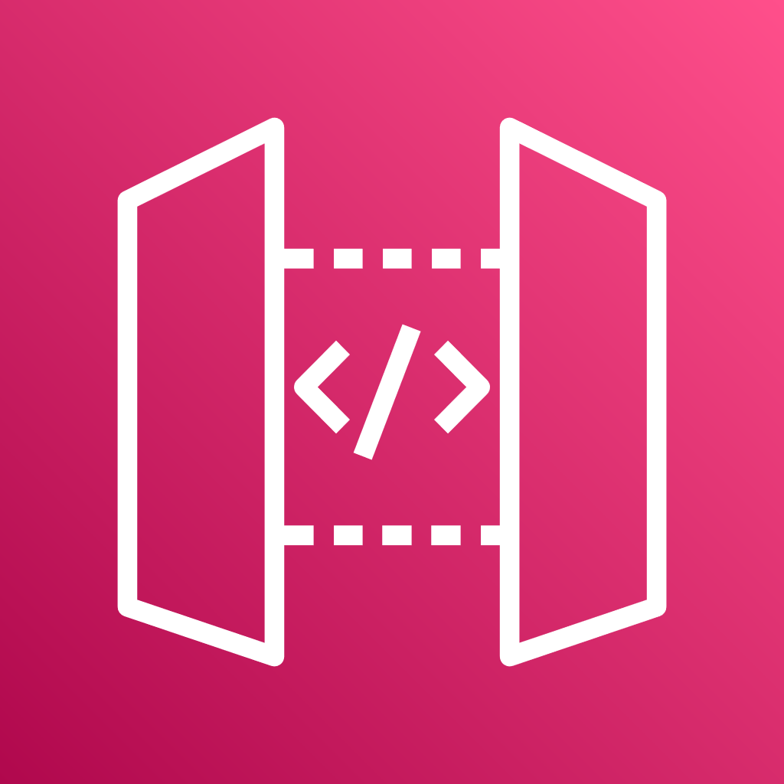
Jenkins: A continuous integration/continuous delivery (CI/CD) tool used to automate the building, testing, and deployment of serverless applications.
GitHub: A version control platform that stores source code and integrates with CI/CD pipelines to trigger deployments of serverless applications.
Lambda: AWS service that runs code in response to events without provisioning or managing servers, ideal for serverless application logic.
S3: AWS service for storing static files (like web assets) and other resources, often used in serverless applications for scalable storage.
API Gateway: AWS service that enables developers to create and manage APIs for serverless applications, acting as a front-end to AWS Lambda.
GitHub Webhook: A mechanism to trigger events in CI/CD tools (like Jenkins) when code changes are pushed to GitHub, automating deployment processes for serverless applications.

Slide 9
jenkins
Continuous Integration/Continuous Deployment tool for automating the pipeline.

Slide 10
Jenkins Setup

Slide 11
Jenkins file Structure
Declarative pipeline with stages such as:
Checkout code.
Install dependencies.
Deploy backend to AWS Lambda.
Upload frontend to S3
Plugins:
. AWS Credentials Plugin for managing AWS credentials.
.GitHub plugins
.NodeJS
pipeline

Slide 12
Jenkins file
pipeline {
agent any
stages {
stage('Checkout SCM') {
steps {
git 'https://github.com/AnuragRajput-cyber/ServerlessApplication.git'
}
}

Slide 13
stage('Install Backend Dependencies') {
steps {
sh 'npm install'
}
}
stage('Deploy Backend') {
steps {
withAWS(credentials: 'aws-credentials') {
sh 'serverless deploy'
}
}
}

Slide 14
stage('Build and Upload Frontend') {
steps {
sh 'npm run build'
withAWS(credentials: 'aws-credentials') {
sh 'aws s3 sync build/ s3://my-frontend-bucket/ --delete'
}
}
}
}
}

Slide 15

Q & A
Panel discussion session

